Slide 1
MORRIS LOUIS
Ian Rolls
Hum 104

Slide 2
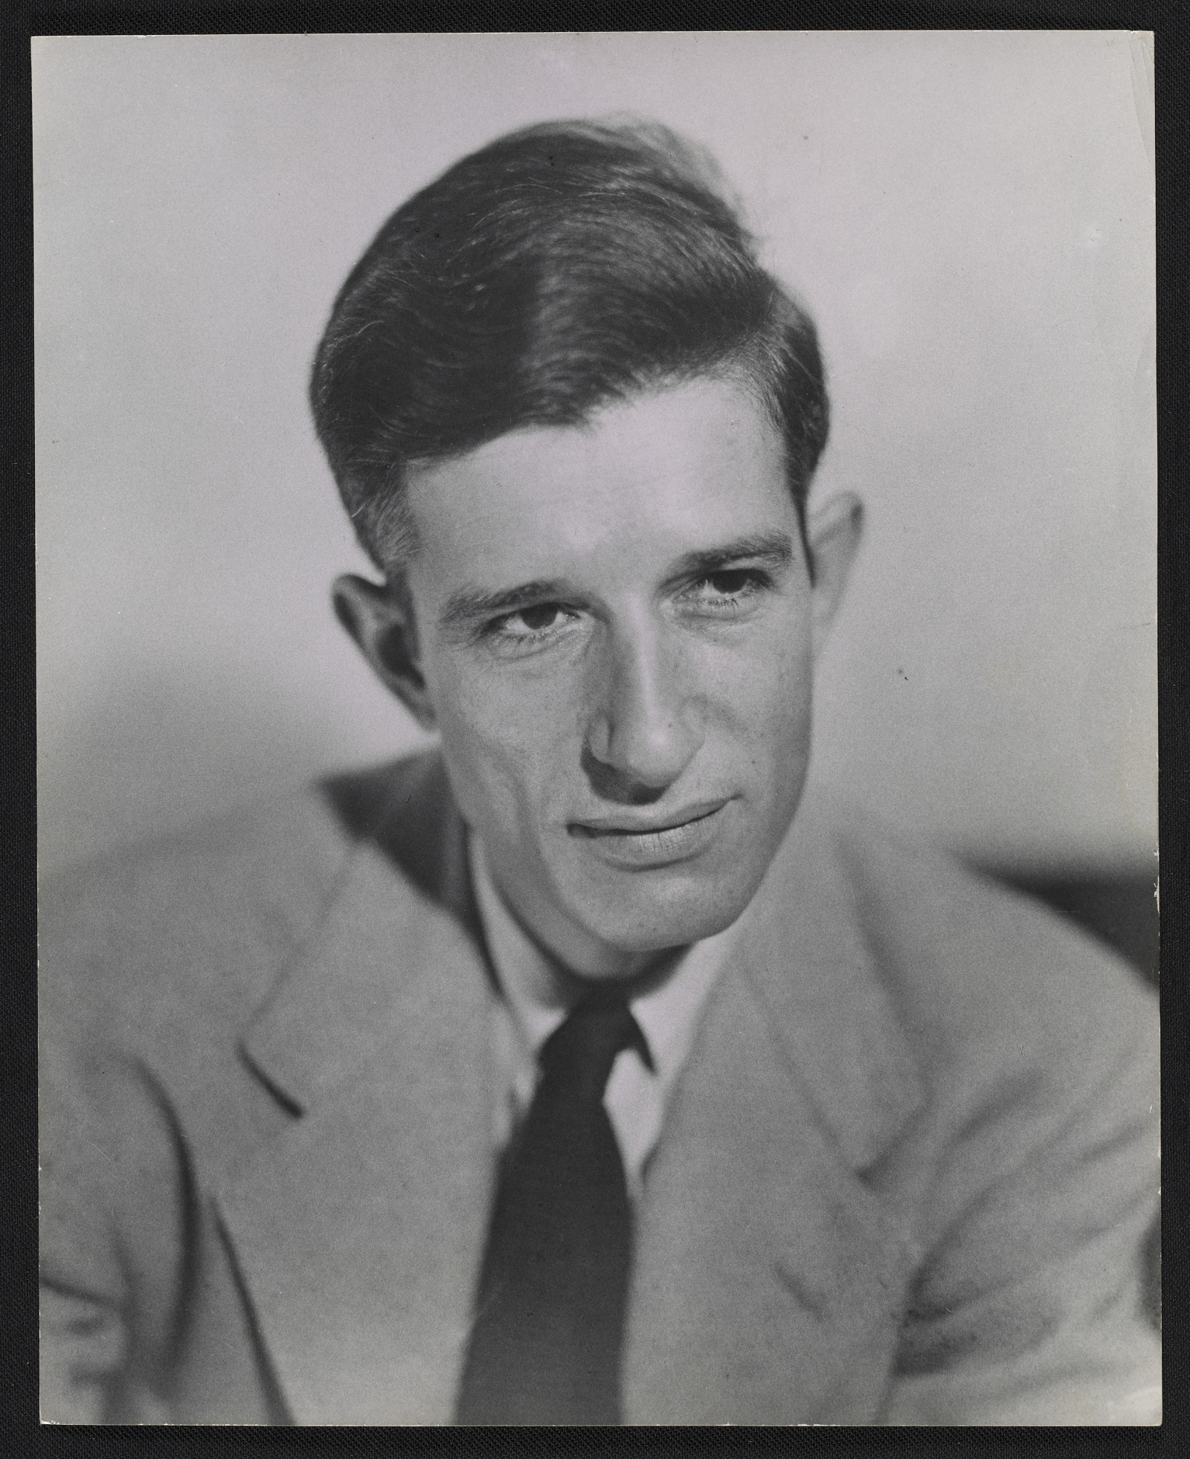
BIOGRAPHY
Born in Baltimore Maryland (1912)
“Maurice Bernstein”
Moved to New York in 1936
Moved to Washington DC
In 1948, began using Magna (Leonard Bocour)
Noland, Greenberg’s Emerging Talent
More than 600 paintings in 8 years
Died in 1962 at the age of 49
Notes:
1948 – Within 6 years, bought 1000 gallons of turpentine to thin out the Magna paint. When magna is combined with turpentine it thins out and gains a matte finish
Magna as a acrylic resin paint – dried much faster

Slide 3
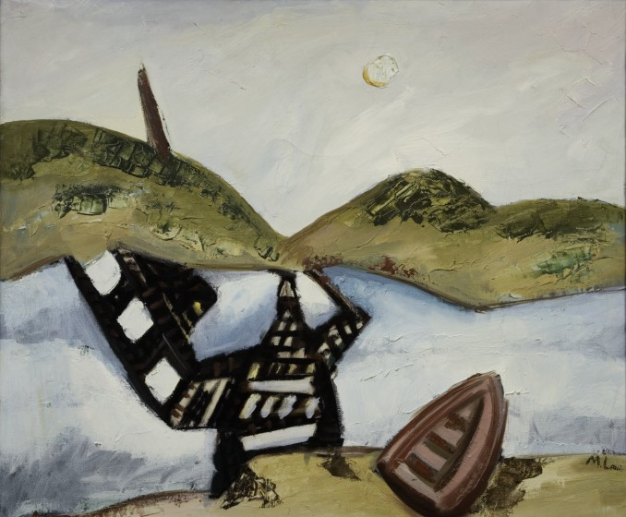
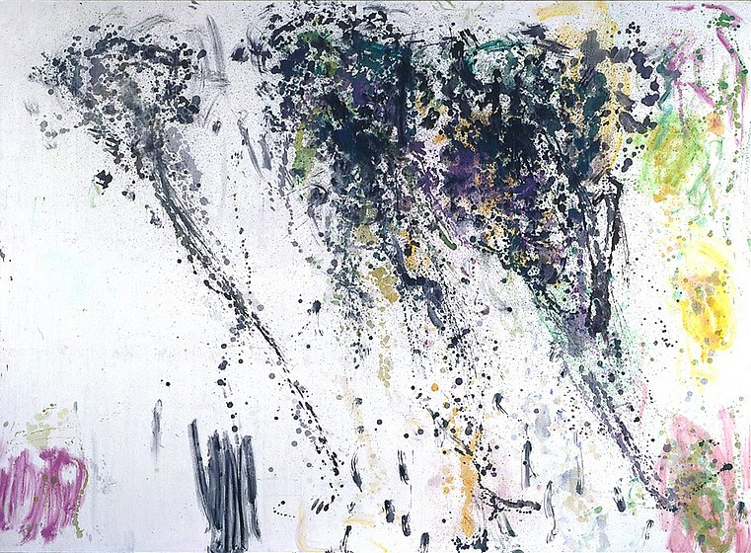
EARLY WORKS
Broken Bridge. 1939. Oil on canvas
Trellis. 1953. Acrylic on canvas

Slide 4
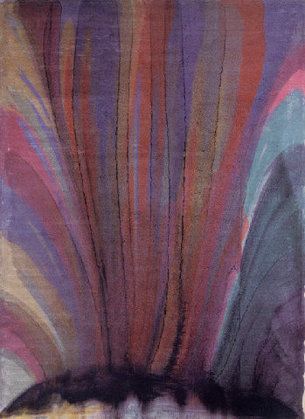
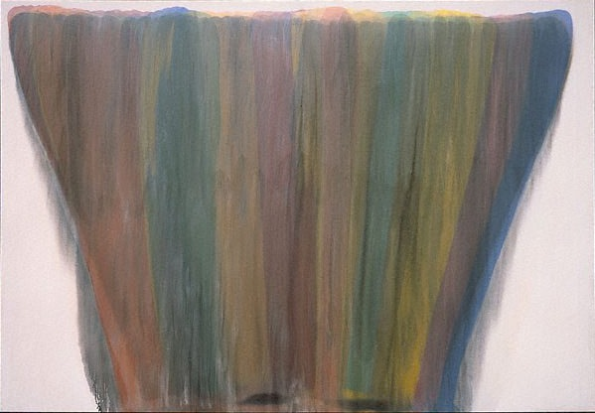
VEILS
Atomic Crest, 1954
Ayin, 1958

Slide 5
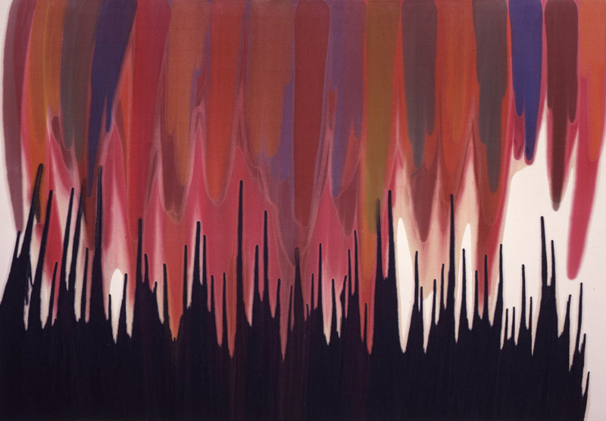

Slide 6
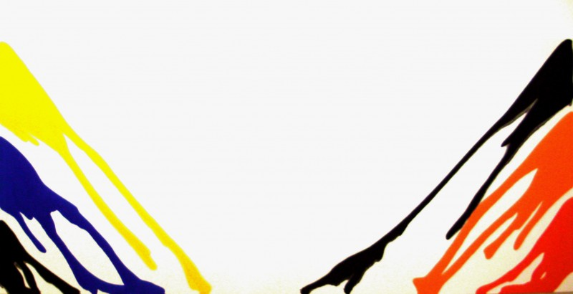
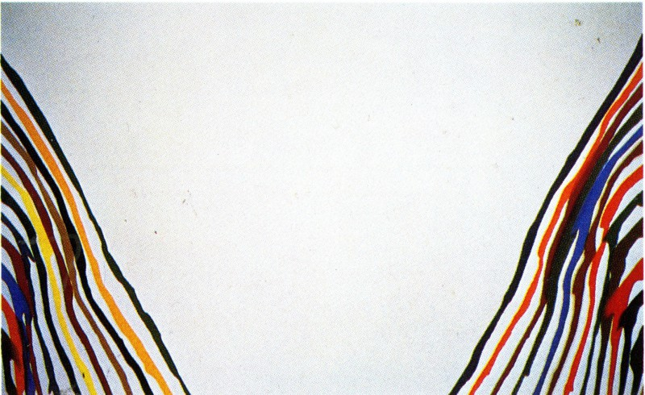
UNFURLED
Gamma Phi, 1961
Alpha Delta, 1960

Slide 7
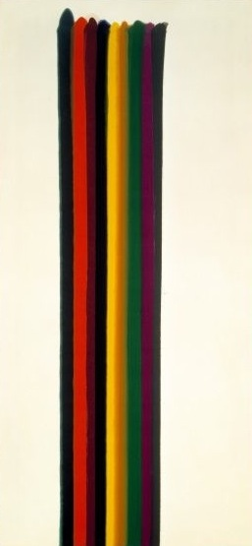
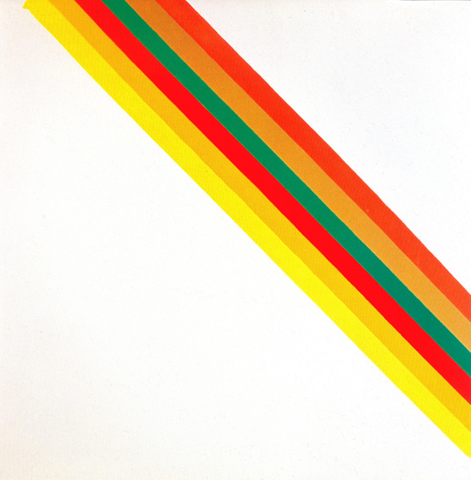
STRIPES
Hot Half, 1962
Happy Friday, 1961

